Slide 1




Databases Advanced
Course Introduction
Databases
Advanced
SoftUni Team
Technical Trainers
Software University
http://softuni.bg

Slide 2



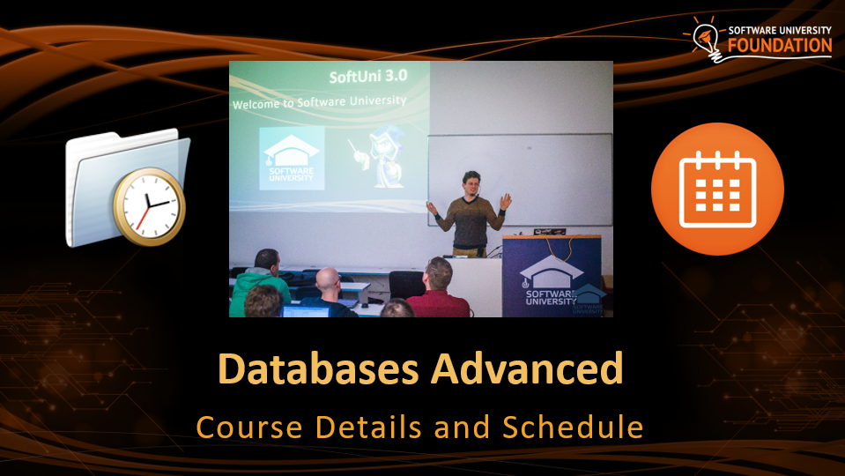




Table of Contents

Slide 3
Questions
sli.do #JavaDB

Slide 4










SoftUni Diamond Partners

Slide 5




Databases Advanced
Course Objectives & Program

Slide 6

Course Objectives
The Databases Advanced course covers
Connecting to local DB instance
ORM, Hibernate and Spring Data
Code-First implementations
Programming Patterns
Working with data in other formats (XML, JSON)

Slide 7



Course Topics
Introduction to DB Applications
Creating Custom ORM Framework
Introduction to Hibernate
Entity Relations in Hibernate
Introduction to Spring Data

Slide 8
Course Topics (2)
Spring Data Advanced Querying
Spring Data Auto Mapping Objects
JSON Processing
XML Processing
Creating Large DB
Exam Preparations

Slide 9

The Trainers Team

Slide 10

Trainers Team
Irina Naskinova
Experience in Java Development
Experience with companies such as ProSyst, Seeburger, Proxiad, HPE …
Cloud Automation Engineer @ DXC Technology
Teacher at Sofia University
Teacher at Cardiff Methropolitan University (Sofia campus)

Slide 11

Trainers Team (2)
Ivan Ivanov
Java Developer @ Codexio
Top performing student from the Software University
Develops APIs and Libraries in his spare time
Interests in back-end web development, Spring, Vert.x and Java Technologies in general

Slide 12


Databases Advanced
Course Details and Schedule

Slide 13

Training Duration and Schedule
Lessons: ~ 50 hours (onsite + YouTube videos)
Practical exercises (in class): ~ 60 hours
Homework: ~ 0-60 hours
Time frame
26 February 2018 – 22 April 2018

Slide 14


Why English?
Why are the slides in English?
English is the native language of the software engineers
Specific terminology should be in English
Translations are inaccurate and funny
Just learn English!
No excuses

Slide 15


Your RFID Chip
Students can either
Take RFID chip from SoftUni
Or use their own chip / card (125 KHz)
Register your chip number in your SoftUni profile: https://softuni.bg/users/profile/show
Check-in at the reception every time when you come in SoftUni
See your last visits in your profile: https://softuni.bg/users/profile/show

Slide 16

Evaluation

Slide 17


Scoring System for the Course
Mandatory:
Final exam – 90%
Exercises & Homework (+ Checks) – 10%
Bonuses:
Presence in class – 5% bonus
Forum activity – bonus up to 5%

Slide 18


Homework Assignments & Exercises
Course activities!
Lesson days → slides + live demos
Exercise days → only exercises
How to submit your homework?
Submitted on the course page in softuni.bg
Do your homework when it's due!
Assignments pile up quickly

Slide 19









Resources
What We Need Additionally?

Slide 20



C# Course Web Site, Forum and FB Group
Official web site:
Official discussion forum:
Official Facebook groups:
softuni.bg/courses/databases-advanced-hibernate
softuni.bg/forum/categories/78/Databases-Advanced-Hibernate
fb.com/groups/SoftUniJavaDBFundamentalsJanuary2018/

Slide 21



The Databases Basics Slides and Videos
All lecture slides, videos, exercises, projects and other resources are open content, available for free
Visit the course web site to access the course resources

Slide 22


Recommended Software
Software needed for this course:
MySQL Server & Workbench | HeidiSQL https://dev.mysql.com/downloads/mysql/
IntelliJ IDEA – https://www.jetbrains.com/idea/?fromMenu
Hibernate and Spring Data

Slide 23



Learn to Search in Internet
The course assignments require to search in Internet
This is an important part of the learning process
Some exercises intentionally have no hints
Learn to find solutions!
Software development includes everyday searching and learning
No excuses, just learn to study!
Developers learn new technologies, tools, languages every day!

Slide 24
Introduction to Databases
https://softuni.bg/courses/databases-advanced-hibernate

Slide 25

License
This course (slides, examples, demos, videos, homework, etc.) is licensed under the "Creative Commons Attribution-NonCommercial-ShareAlike 4.0 International" license

Slide 26





Trainings @ Software University (SoftUni)
Software University – High-Quality Education, Profession and Job for Software Developers
softuni.bg
Software University Foundation
http://softuni.foundation/
Software University @ Facebook
facebook.com/SoftwareUniversity
Software University Forums
forum.softuni.bg

